Slide 1

Racial Disparities in Marijuana-Related Arrests
Tim Arthur and Trinity Lakin
Data
Marijuana arrest data from the city of Los Angeles, California, USA
Years 2010 - 2019
Obs after cleaning: 22,670
Research Question(s)
Did the legalization of cannabis in California (in 2016) narrow racial differences in marijuana-related arrest rates?
Predictor Variable
Year - Before & after 2016 (legalization in CA)
Outcome Variable(s)
Race of arrestees - Categorical - Asian, Black, Hispanic, White, Other
Analytic Plan
T-test
Regression

Slide 2
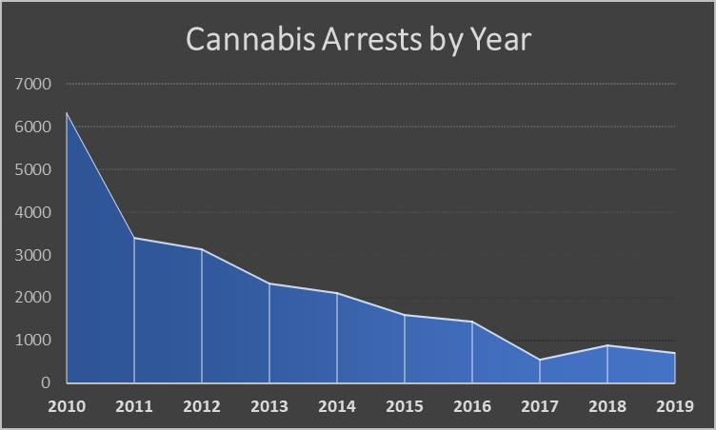
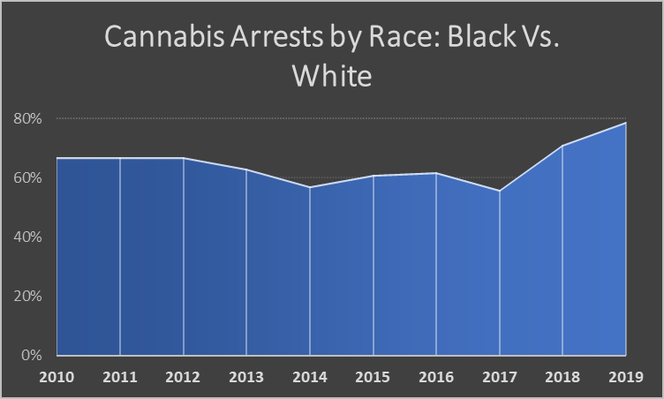
Results & Data Visualization
In Los Angeles, Black folks are 33% more likely to be arrested for cannabis related offenses post-legalization (2016) than other races and 29% more likely to be arrested for cannabis related offenses post-legalization than Whites

